Slide 1

Chandigarh School of Business, Jhanjeri
Department of Computer Application
Program Code: NA
Program Name: MCA
Course Code: PGCA1937
Course Name: Cloud Computing
Prepared by: Dr. Gurvir Kaur

Slide 2

Outlines
PTU Syllabus of Unit-I
CO’s Introduction
Topic Overview
Brief description of what the presentation will cover
Importance or relevance of the topic
Key objectives or learning outcomes
Summary
References

Slide 3
PTU Syllabus of Unit-I
Part-A
Overview of Computing Paradigm: Recent trends in Computing -Grid Computing, Cluster Computing, Distributed Computing, Utility Computing, Cloud Computing.
Introduction to Cloud Computing: Vision of Cloud Computing, Defining a Cloud, Cloud Reference Model, Deployment Model, Characteristics, Benefits of Cloud Computing, Challenges ahead. Cloud computing vs. Cluster computing vs. Grid computing.
Migrating into a Cloud: Introduction, Broad approaches to Migrating into the Cloud, The Seven-Step Model of Migration Into a Cloud.
Virtualization: Introduction, Characteristics of Virtualized environment, Taxonomy of Virtualization techniques, Virtualization and Cloud Computing, Pros and Cons of Virtualization, Technology Examples- Xen, VMware, Microsoft Hyper-V.
Capacity Planning: Introduction, Defining Baseline and Metrics-Baseline Measurements, System Metrics, Load Testing, Resource Ceilings, Server and Instance types; Network Capacity, Scaling.

Slide 4
Key objectives or learning outcomes
CO1 Understand the basic concept and importance of cloud computing.
CO2 Access the suitability of migrating to a cloud solution for different applications.
CO3 Compare and evaluate the virtualization technologies.
CO4 Monitor and manage the cloud resources, applications and data while addressing the security concerns.
CO5 Use cloud solutions offered by industry leaders for various applications.

Slide 5
CO Introduction
CO NUMBER | TOPICS | LEVEL
CO2 | Migrating into a Cloud: Introduction, Broad approaches to Migrating into the Cloud, The Seven-Step Model of Migration Into a Cloud. Virtualization: Introduction, Characteristics of Virtualized environment, Taxonomy of Virtualization techniques, Virtualization and Cloud Computing, Pros and Cons of Virtualization, Technology Examples- Xen, VMware, Microsoft Hyper-V. Capacity Planning: Introduction, Defining Baseline and Metrics-Baseline Measurements, System Metrics, Load Testing, Resource Ceilings, Server and Instance types; Network Capacity, Scaling. | 2

Slide 6
Topic Overview
Virtualization is the process of creating virtual versions of physical hardware, enabling multiple operating systems or applications to run on a single machine.
It is characterized by scalability, resource optimization, isolation, and abstraction.
Virtualization techniques include hardware, software, and network virtualization, forming the foundation for cloud computing by enhancing efficiency and flexibility.
Examples include technologies like Xen, VMware, and Microsoft Hyper-V, each offering unique features and use cases while presenting pros such as cost savings and cons like potential performance overhead.

Slide 7
Brief of what the presentation will
The presentation will cover the following points:
Virtualization:
Introduction
Taxonomy of Virtualization techniques
Virtualization and Cloud Computing

Slide 8
Importance of the topic
Optimized Resource Utilization:
Virtualization maximizes hardware efficiency by running multiple virtual environments on a single physical system, reducing costs and improving scalability.
Foundation for Cloud Computing:
It enables dynamic provisioning, resource pooling, and flexibility, making it a key enabler for cloud computing infrastructure and services.
Technological Advancements and Versatility:
With tools like Xen, VMware, and Microsoft Hyper-V, virtualization supports diverse use cases, including testing, development, disaster recovery, and workload isolation.

Slide 9
Detail Topics
Virtualization is the process of creating virtual versions of physical resources, such as servers, storage devices, or networks. It allows multiple operating systems or applications to run independently on the same hardware.
The primary goal is to optimize resource utilization, reduce hardware dependency, and enable flexibility by abstracting the physical layer and presenting it as virtual instances.
Virtualization plays a critical role in modern IT infrastructure by enhancing scalability, cost-efficiency, and performance, while serving as the foundation for cloud computing and software-defined data centers.

Slide 10
Virtualization
Virtualization involves creating virtual instances of physical resources to optimize utilization.
Enhance resource efficiency, enable scalability, and improve flexibility.
Virtualization is the foundation for cloud computing.
The different types of virtualization techniques used in IT environments.

Slide 11
Taxonomy of Virtualization Techniques
Virtualization techniques can be categorized into several layers of abstraction.
Key Types: Hardware, software, storage, and network virtualization.
Each technique has distinct benefits, depending on the environment and use case.
Virtualization helps optimize IT resource management, increase flexibility, and reduce costs.

Slide 12
Hardware Virtualization
Virtualizing physical hardware to run multiple operating systems
on one machine.
Hypervisors (Type 1 & Type 2) create and manage virtual machines.
Maximize hardware utilization and support legacy applications.
Examples: VMware, Microsoft Hyper-V, Xen.

Slide 13
Software Virtualization
Virtualization of software resources, enabling isolated environments for applications.
Running multiple software instances on a single system without affecting performance.
Simplifies testing, development, and management.
Examples: Docker, VMware Workstation.

Slide 14
Storage Virtualization
Abstracting storage resources from physical hardware.
Pooling multiple storage devices into a single virtualized storage unit.
Simplifies storage management, improves utilization, and enhances data availability.
Examples: SAN (Storage Area Network), NAS (Network-Attached Storage).

Slide 15
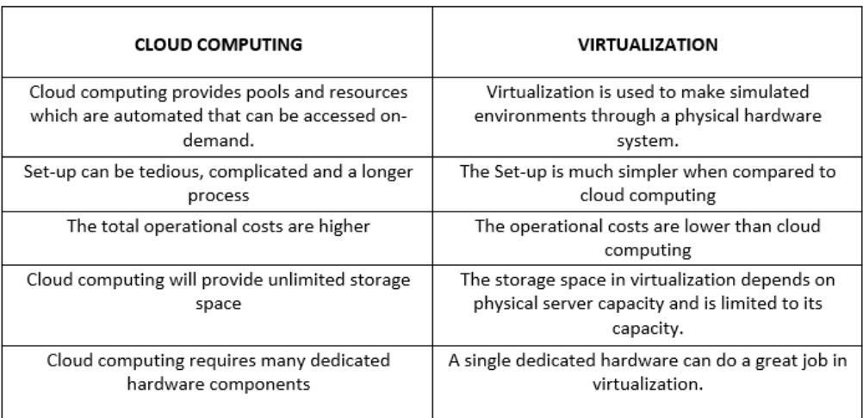
Virtualization vs. Cloud computing

Slide 16
Summary
Virtualization Techniques: Hardware, software, storage, and network virtualization each offer unique advantages.
Role in Cloud Computing: Virtualization enables the cloud's on-demand, scalable, and flexible nature.
Key Technologies: Xen, VMware, and Microsoft Hyper-V are prominent examples of virtualization platforms.
Future Trends: Virtualization will continue to evolve with innovations in containerization, serverless computing, and edge computing.

Slide 17
References
Books References
Mastering Cloud Computing, Rajkumar Buyya, Christian Vecchiola, and ThamaraiSelvi, Tata McGraw Hill, ISBN-13: 978-1-25-902995-0, New Delhi, India,Feb 2013.
E-book link
https://archive.org/details/cloudcomputingbi0000sosi
YouTube link
https://www.youtube.com/@cloudcomputing351/videos
https://www.slideshare.net/slideshow/cloud-migration-presentation-246744264/246744264?from_action=download&slideshow_id=246744264&original_file=true
https://www.geeksforgeeks.org/7-steps-of-migrating-model-in-cloud/
https://nptel.ac.in/courses/106105167
https://www.edx.org/learn/cloud-computing

Slide 18
THANK YOU

